Slide 1
Python programming
unit 1B – assignment with return

Slide 2
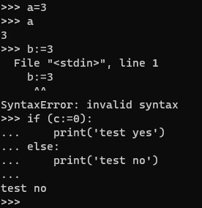
:=
=
Bind a name (or names) with a value (or values)
:=
Besides normal bind, it also return the value
Only with one value assignment, not able to do unpack like ‘=‘
Can only be used in conditional test, argument passing, etc. Which immediately use the return value

